Slide 1
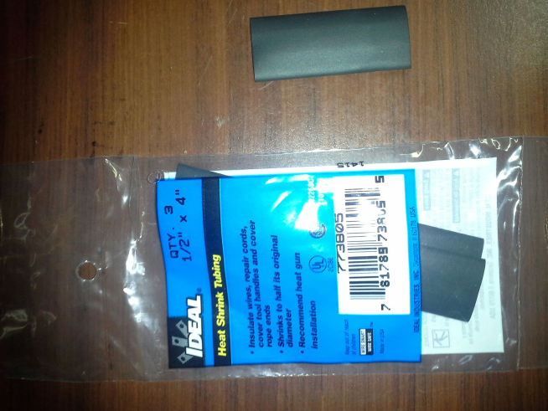
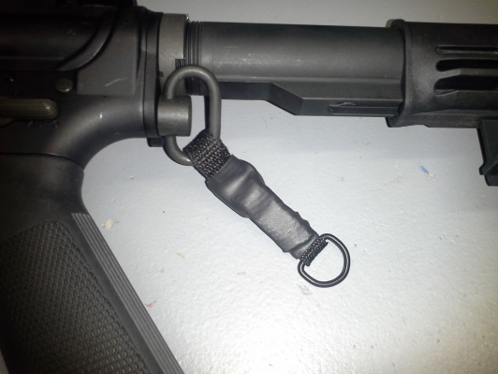
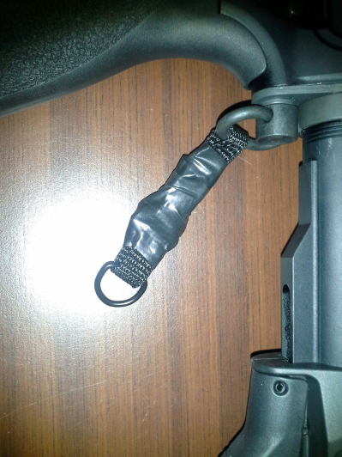
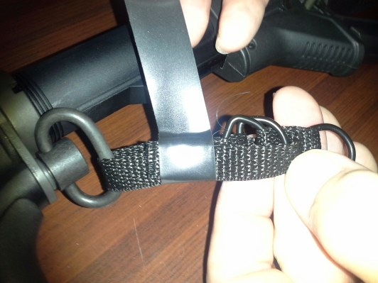
Chalker Sling Standoff
It is Imperative that a Standoff is used on every weapon.
Every Standoff on every weapon must be either taped or Heat Shrink used to make it permanent and not slip off.
Heat Shrink Tubing (purchase at any hardware store) is the most secure way. Use ½” once Standoff is secured on weapon.
Electrical or Duct Tape works very well to secure stand off. Adjust Standoff to proper length then tape
Go to www.jerseytactical.com and click on the Dennis Chalker video for detailed instructions

